Slide 1
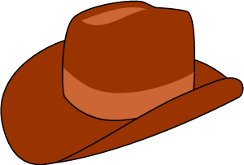
Harry Potter in the West
Gina-Josephine, Leonardo Pedrazzoli, Rebecca Francker & Natalia Rogon

Slide 2
Links to the Production
Gina: http://gina-josephine.eu/harrypotter_western_animation/index.html
Leo: http://leodesign.dk/kea/harrypotter/index.html
Rebecca: http://rfrancker.com/harrypotter_western_animation/index.html
Natalia: http://natalia-rogon.com/harrypotter_western_animation/index.html

Slide 3
Team members & Responsibilities
Gina: Code, Testing & Sound
Leo: Animation & Graphics
Rebecca: Process Assignments, Graphical Elements, Testing
Natalia: Help with Storyboard, Persona Collage & Graphics

Slide 4
Collaboration Agreement
Be there when we agree to be
Let group know if you are unable to come in or complete your task
If the rules are broken the group member looses the right to influence the decisions made at the given time

Slide 5
The Assignment
Story: Harry Potter
Style: Western
Music: Bob Dylan/Johnny Cash: Girl from the North Country

Slide 6
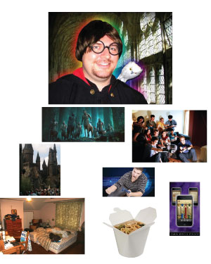
Persona Collage
Persona: - young (below 30 yo) - into games - has many friends with the same interests - student / working in corpo - eats a lot of takeaways - generally ambitious but not so good in housekeeping

Slide 7
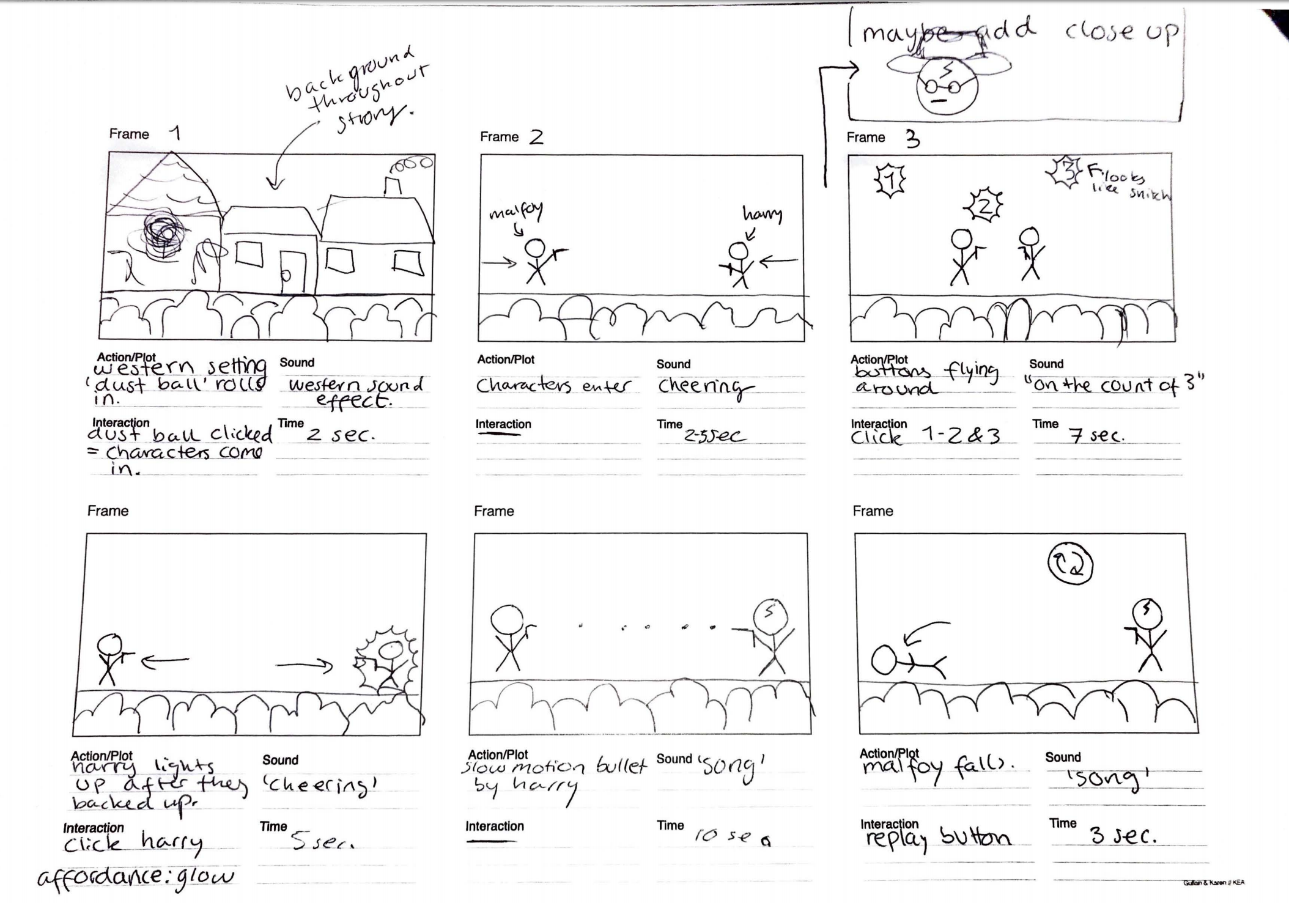
Story Board

Slide 8
Colored Divs
http://gina-josephine.eu/harrypotter_animation/index.html

Slide 9
Character Design, Backgrounds & Typography
Background:
Dry desert w/ rocks, cacti, mountains
Colors: shades of yellow, orange, brown, green & blue
Characters
Dark wizard clothes, ordinary cowboy hats, elements from Hogwarts houses
Harry: Orange and red scarf – Gryffindor house
Malfoy: Green and white bandana – Slytherin house
Typography
Two Western style typography and one harry potter font
“Cowboys” “Texas Tango” “harry P.”

Slide 10
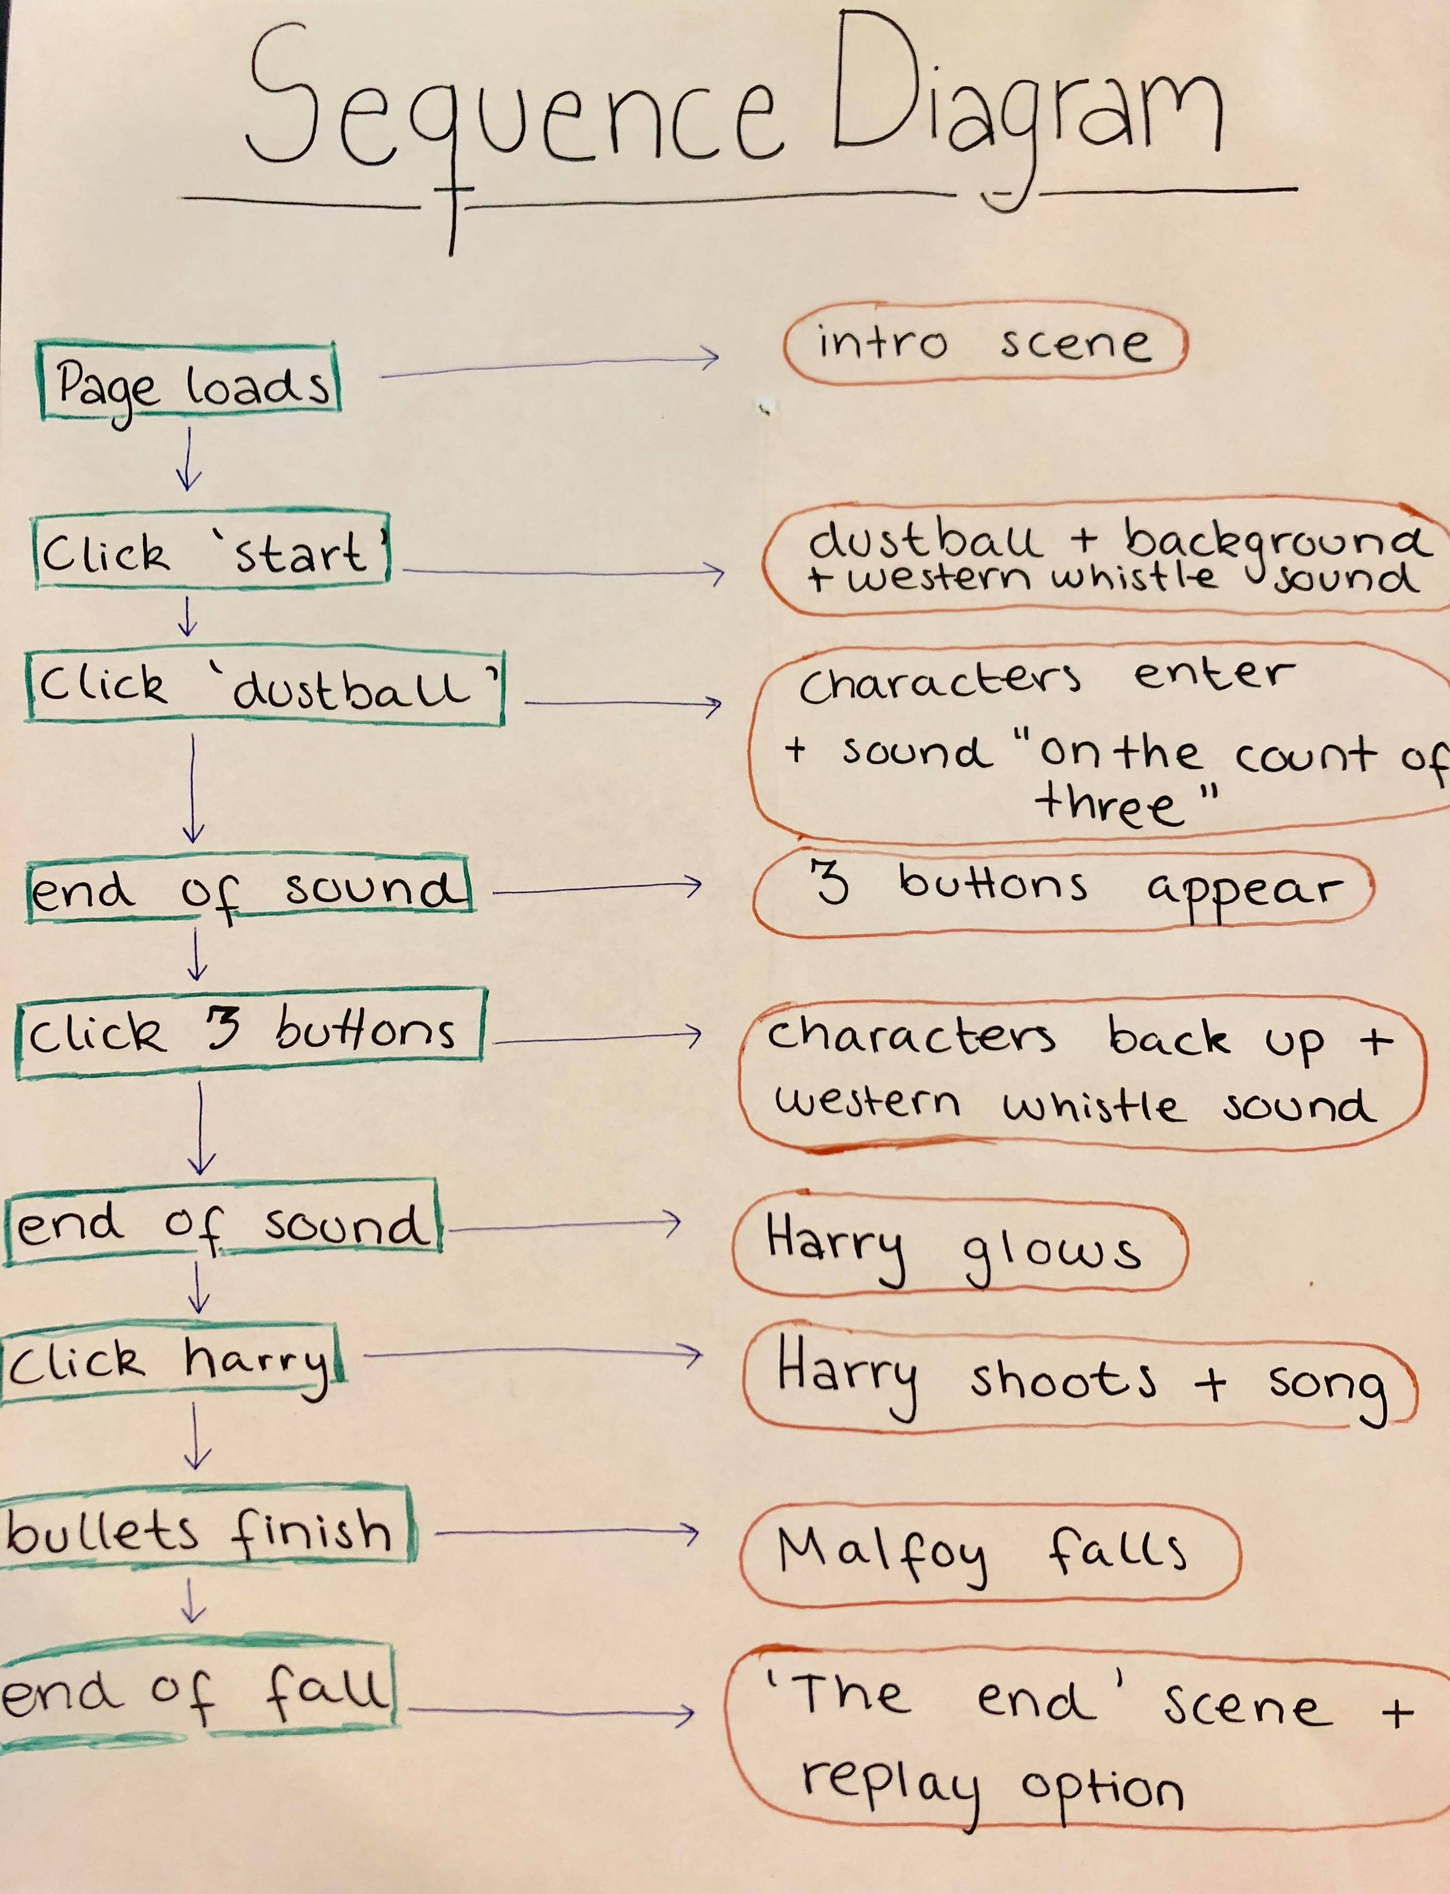
Sequence Diagram
We made a sequence diagram to know how to implement our code and which functions should start our animations.

Slide 11
Example of Code
HTML & CSS
JAVASCRIPT
<div id="childDiv"> </div>
#childDiv { top: 87vh; width: 100vw; height: 15vh; cursor: pointer; position: absolute; z-index: 500; display: none; }
let cowboyCrowd = document.querySelector("#childDiv");
cowboyCrowd.style.display = "block"; cowboyCrowd.addEventListener('click', function () { cheering.play(); });

Slide 12
Expert Test
What movie is this from?
Who are the characters?
What style were we given?
Do you have any ideas for “Easter eggs”?
Is the interaction obvious?
Is the animation missing something?

Slide 13
Interactive Story
Plot
19th century American old West
Gunfight between cowboys
Harry Potter movie
Vast landscape of Desert and mountains
http://leodesign.dk/kea/harrypotter/index.html

Slide 14
Future Enhancements
Making the crowd move when cheering for affordance as well
Make the snitches move around for a magic flying element
blood on Malfoy or wheelchair for a more apparent ending
pulsing of tumbleweed
walk back
implement closeup image

Slide 15
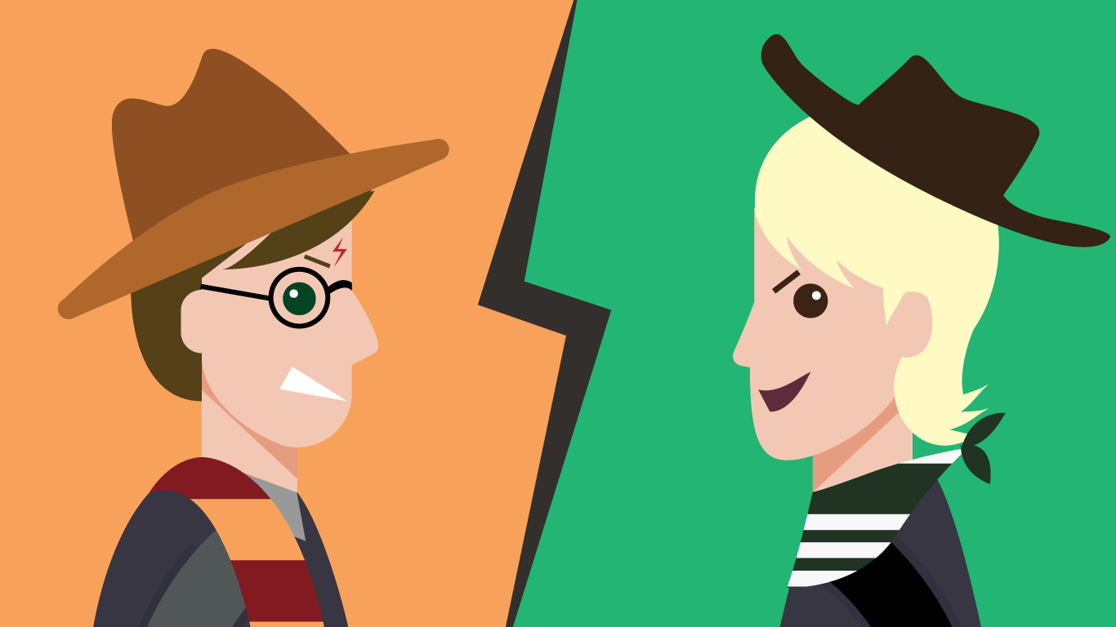
Close up

